Slide 1
RISC-V External Debug Security TG
Meeting notes – 12/11/2023

Slide 2
Disclaimer
https://docs.google.com/presentation/d/1LNhpuNwU54TgwGfcl-Fgf4HUFxCxh0AztPaeqMuRQRw/edit#slide=id.p1

Slide 3
Agenda
TG update
Meeting time
Charter update
Discuss arch opens
https://github.com/riscv/riscv-smmtt/issues/11

Slide 4
Introduction
Welcome to TG meeting
Feel free to raise your hand and introduce yourself

Slide 5
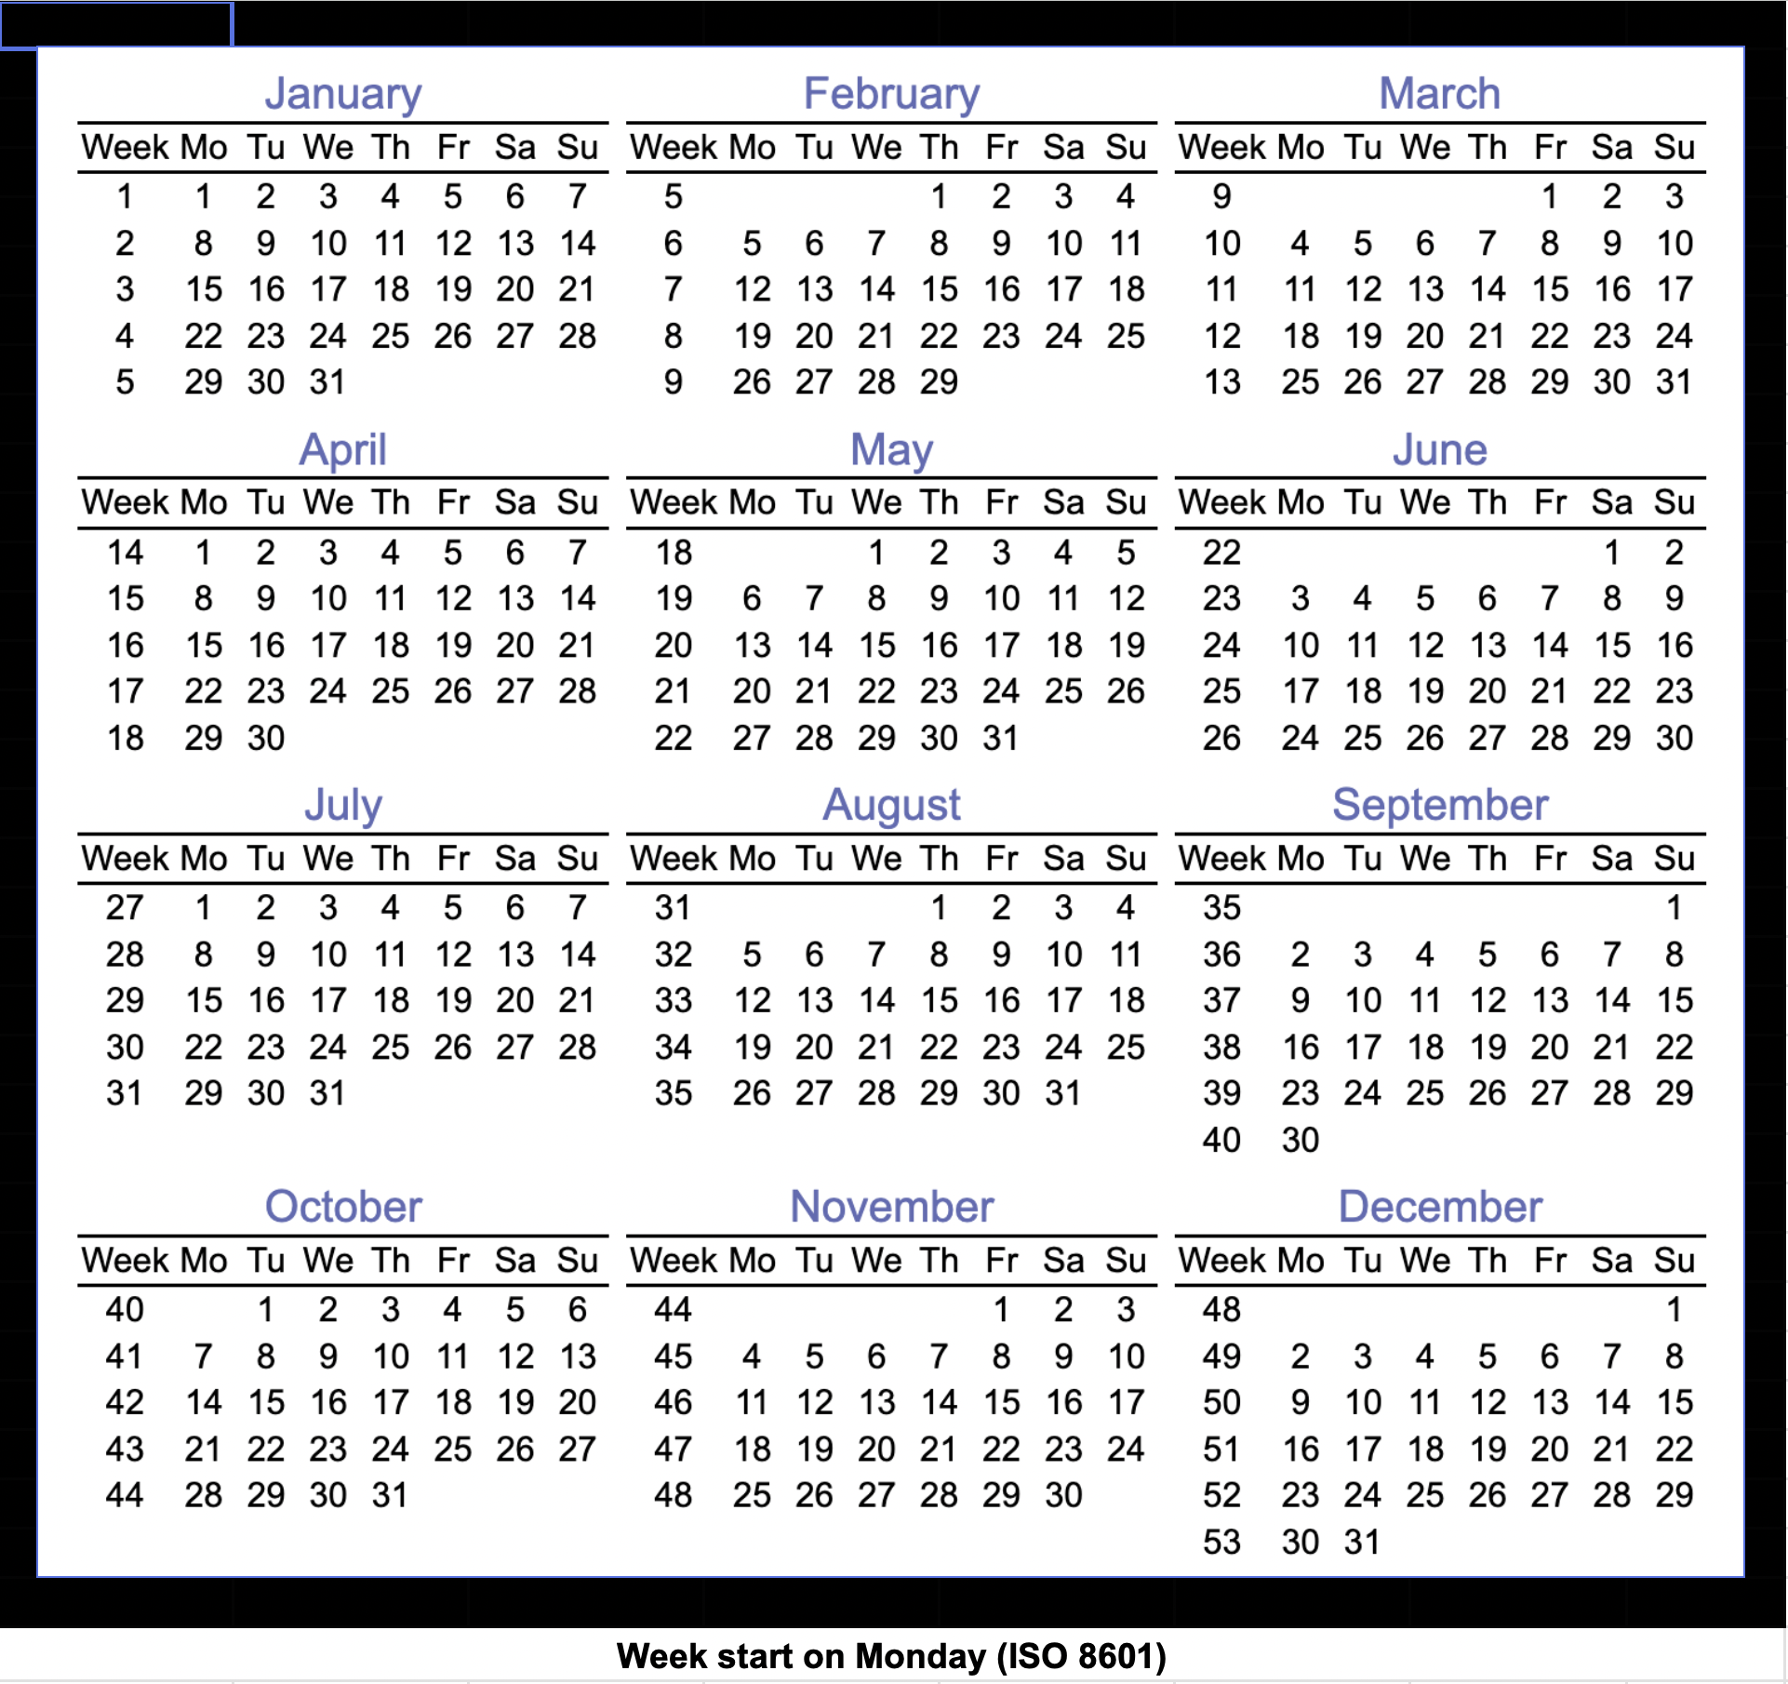
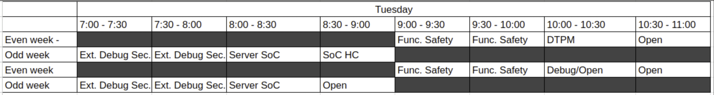
New meeting time
Foundation shuffle all TG meetings to avoid conflict
Ext. Debug sec. TG meeting time assigned to new time, see below
Next TG meeting likely 1/15/2024

Slide 6
TG Progress (Updates in blue)
Charter
Made minor change accroding to new feedback
Chair & Vice chair election (Updates in blue)
Create ”call for candidate” ticket in github - Done (Ticket)
Governing and Dotted-line Chairs to review the required qualification
Blessed by Security HC chair (Andy), waiting for SOC HC chair (Ved)
Governing HC/IC chair send call-for-candidate email – Need to update charter according to new feedbacks
Collect candidate list, interview – Pending
Nominee & approve – Pending
Notes:
AI – Joe to Provide link to the existing draft in the notes

Slide 7
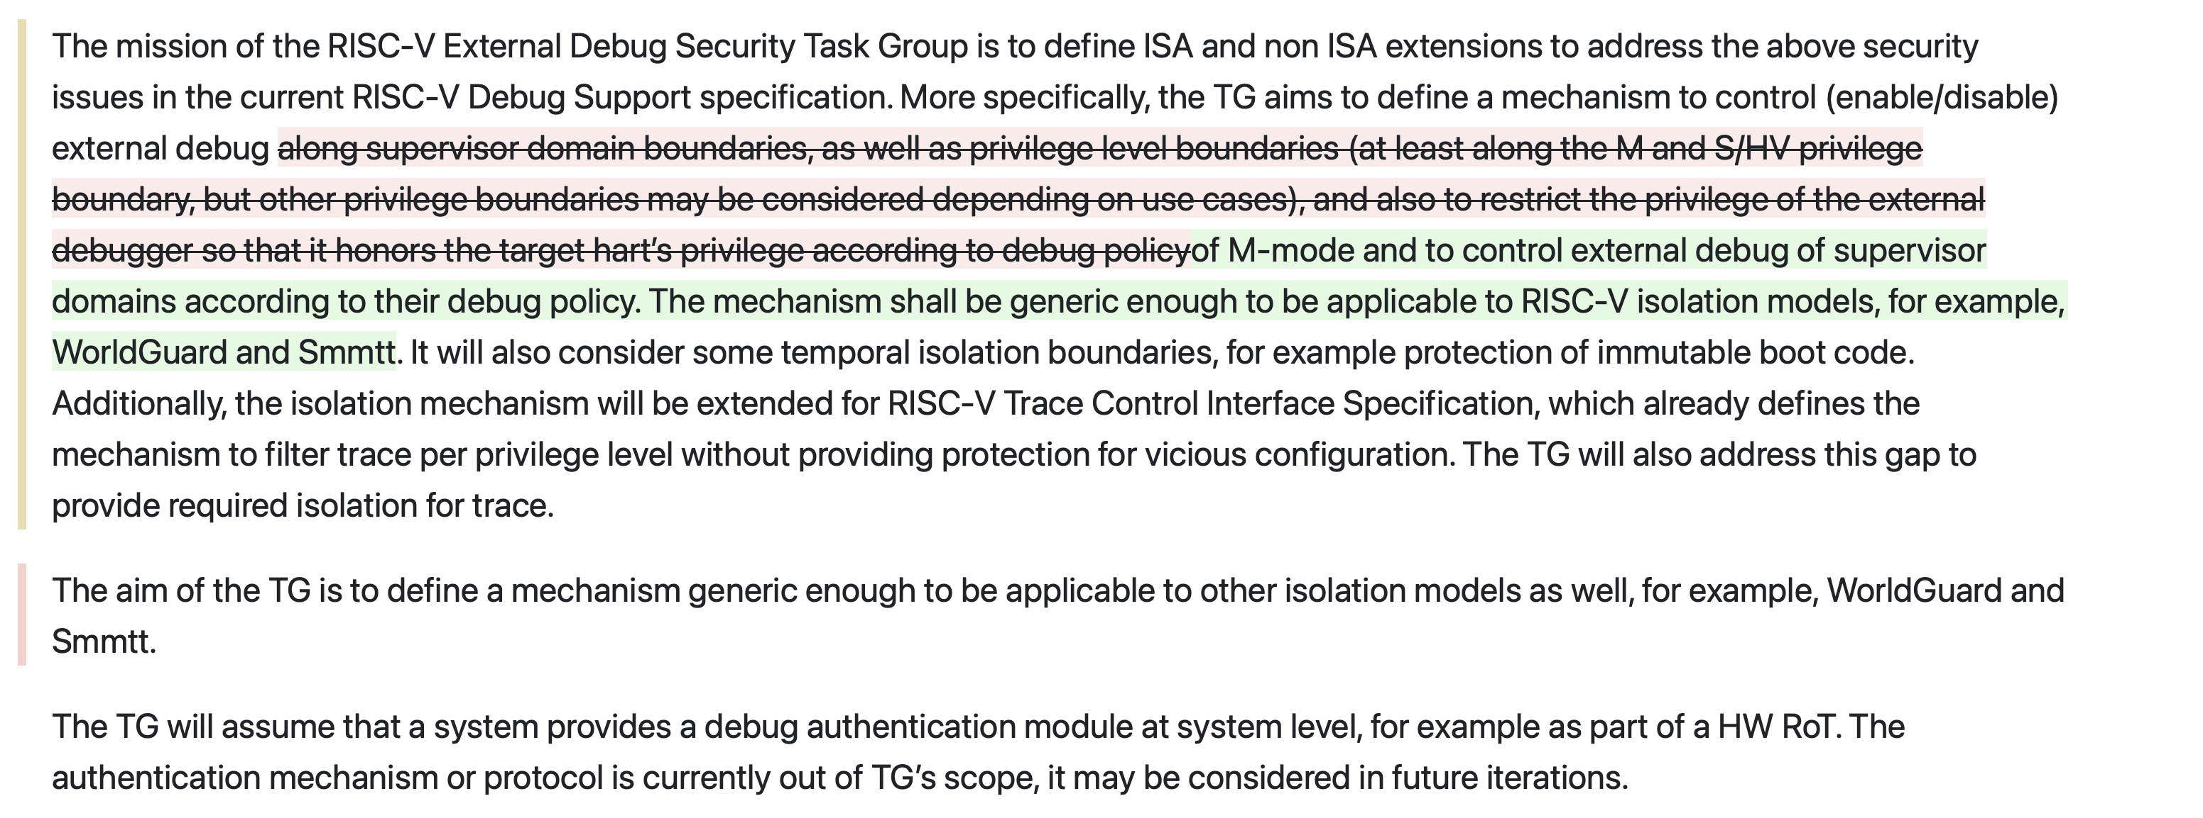
Charter update
https://github.com/riscv-admin/external-debug-security/pull/5
Notes:
Avoid wording of Smmtt or explain the meaning of Smmtt? Supervisor domain isolation? WorldGuard?

Slide 8
Meeting notes
Charter
https://github.com/riscv/riscv-smmtt/issues/11
Agreed to remove M mode control from proposal
Allow M mode to enable debug for itself is a security concern
Hierachical security control - RoT enables debug for non-RoT hart, RoT BR enables debug for its M mode via hardware (e.g. life cycle FSM) out of hart
Agreed to simplify the proposal to remove per priv level control
Agreed to split debug control to separate extension, TBD on which CSR to use

Slide 9
Call for candidate – Chair/Vice Chair
Required Technical Qualifications
Knowledgeable in RISC-V debug architecture, RISC-V external debug spec and trace spec
Knowledgeable in RISC-V security architecture, isolation model and related specs
Experience with threat modeling and security architecture analysis
Experience in platform/SOC/CPU security architecture and aspects related to debug security
Community Charter
https://github.com/riscv-admin/external-debug-security/blob/main/CHARTER.md

Slide 10
Information & Logistic
TG Charter
https://github.com/riscv-admin/external-debug-security/blob/main/CHARTER.md
TG Meeting notes
https://github.com/riscv-admin/external-debug-security/tree/main/meetings
Draft
https://github.com/joxie/riscv-debug-security/blob/main/spec/Secure%20Debug%20Proposal.md (Stable version)
https://github.com/joxie/riscv-debug-security/blob/dev/spec/Secure%20Debug%20Proposal.md (Dev branch)
https://github.com/joxie/riscv-debug-security/issues (Open issues)

Slide 11
Backup Slides

